Slide 1
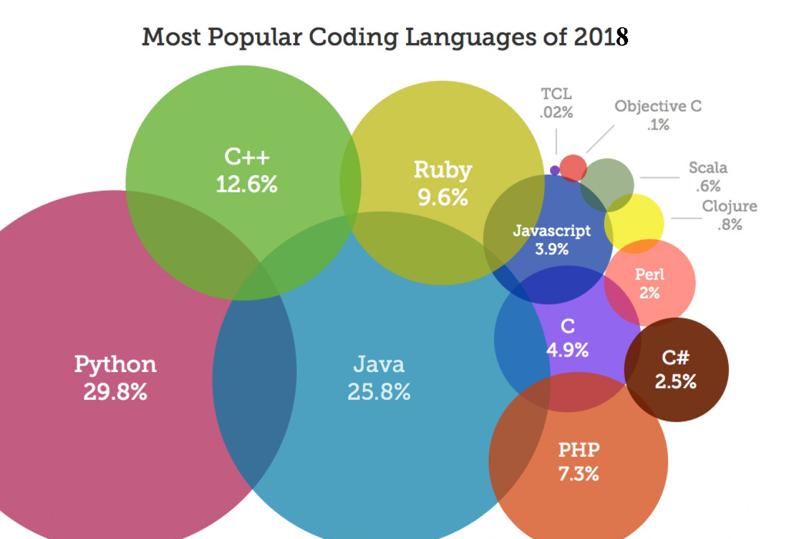
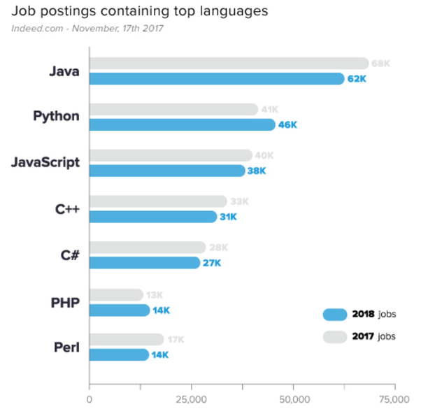

Slide 2

Introduction
Python is a general purpose, interpreted and high-level programming language
It’s design philosophy emphasizes code readability.
Its syntax are said to be clear and expressive.
Python interpreters are available for many operating systems.
Like Java, once written, programs can be run on any operating system.
T Seshu Chakravarthy Department Of Computer Science and Engineering

Slide 3
History
The history of Python starts with ABC.
Python was conceptualized by Guido Van Rossum in the late 1980s.
It was in late 1980’s, when Guido van Rossum came up with an idea to develop a programming language while working in CWI(Centrum Wiskunde and Informatica), Amsterdam, for a project named Amoeba which is a distributed operating system.
He along with his team was using ABC language for their project which was not able to handle exceptions and interface with the Amoeba Operating System.
T Seshu Chakravarthy Department Of Computer Science and Engineering

Slide 4
History
In December, 1989, he actually started implementing his ideas to develop a new programming language that is capable of exception handling with several other programming paradigms.
Rossum being a big fan of a British sketch comedy series, Monty Python’s Flying Circus, named the language as Python.
Python came into sight on 20 Feb, 1991 for the very first time with a version 0.9.0.
T Seshu Chakravarthy Department Of Computer Science and Engineering

Slide 5
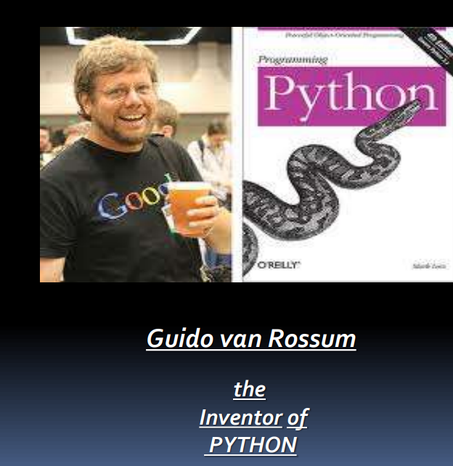
T Seshu Chakravarthy Department Of Computer Science and Engineering

Slide 6
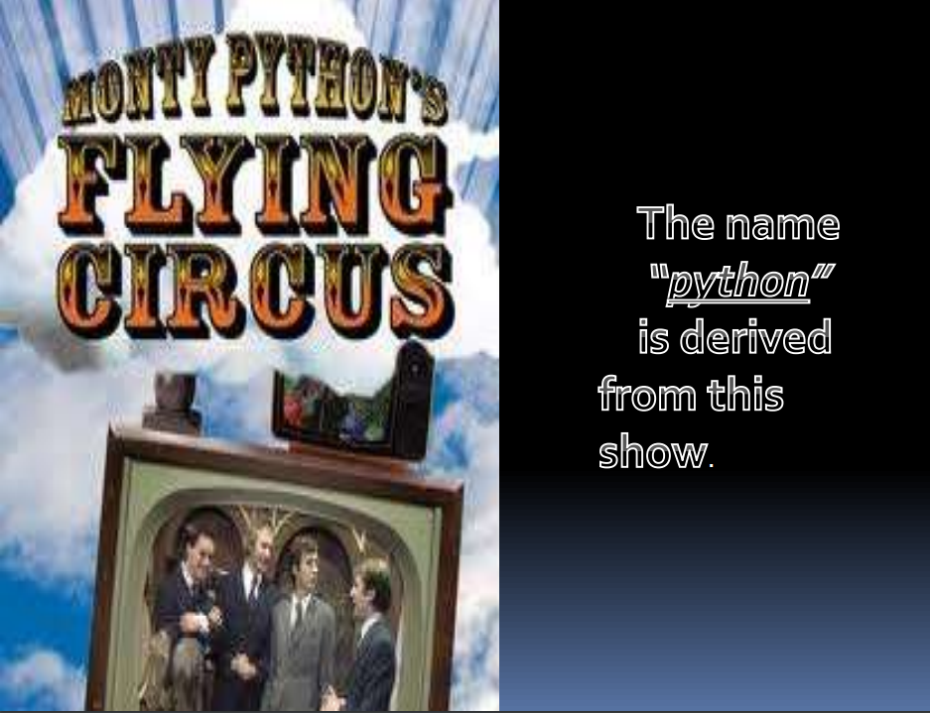
T Seshu Chakravarthy Department Of Computer Science and Engineering

Slide 7
History
Python 0.9.0 - February 20, 1991
Python 1.0 - January 1994
Python 2.0 - October 16, 2000
Python 3.0 - December 3, 2008
Python 3.7 - June 27, 2018
Python 3.11 -November 2022,
Python 3.12.0 2 October 2023
T Seshu Chakravarthy Department Of Computer Science and Engineering

Slide 8
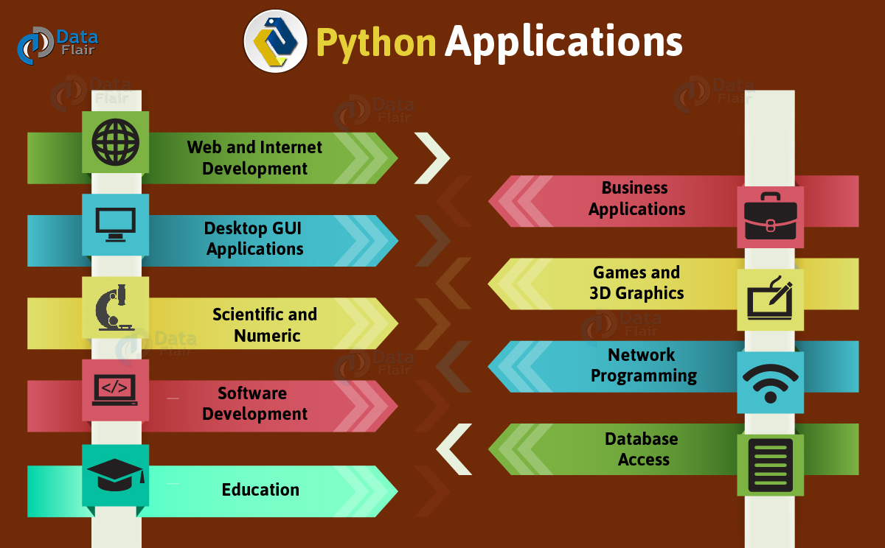
T Seshu Chakravarthy Department Of Computer Science and Engineering

Slide 9
Running Python scripts
Method One: Interactive Mode
The most basic way to run code is to enter and run lines of code in the Terminal.
start Python by typing in python at the $ command prompt, type in print "Hello and hit enter.
Ex :
>>> print(“hello”)
o/p :hello
T Seshu Chakravarthy Department Of Computer Science and Engineering

Slide 10
Running Python scripts
Method 2: Running a Python Script in the Terminal
Python code is written in plain text files, typically given a “.py” extension.
Open up a Terminal window. Let’s say you saved your script with the name hello_world.py in your Documents folder.
Navigate to the Documents folder by typing in cd Documents and hit enter.
Then to run your code type in python hello_world.py and hit enter. Your code will run and you’ll see the output.
$python hello_world.py
T Seshu Chakravarthy Department Of Computer Science and Engineering

Slide 11
Running Python scripts
Method 3: Running a Python Script in Jupyter notebook
Install the classic Jupyter Notebook with:
pip notebook
To run the notebook:
jupyter notebook
T Seshu Chakravarthy Department Of Computer Science and Engineering

Slide 12
Example Program
name="Devansh"
age=6
print("Name:",name)
print("Age:",age)
T Seshu Chakravarthy Department Of Computer Science and Engineering

Slide 13
program to convert height in feet and inches to cm. [1 feet = 12 inch and 1 inch= 2.54 cm
print("Input your height: ")
h_ft = int(input("Feet: "))
h_inch = int(input("Inches: "))
h_inch += h_ft * 12
h_cm = round(h_inch * 2.54, 1)
print("Your height is : %d cm." % h_cm)
T Seshu Chakravarthy Department Of Computer Science and Engineering

Slide 14
Comments in python
Single line comments:
# This would be a comment in Python
Multi line comments:
“””” This would be a multiline comment in Python that spans several lines and describes your code, your day, or anything you want it to … “””
T Seshu Chakravarthy Department Of Computer Science and Engineering

Slide 15
Variables
A Python variable is a reserved memory location to store values.
A variable is a symbolic name for this physical location.
This memory location contains values, like numbers, text or more complicated types.
i = 42
S=“hi”
Z=10.5
T Seshu Chakravarthy Department Of Computer Science and Engineering

Slide 16
Cont ..
Ex:
counter = 100 # An integer assignment
miles = 1000.0 # A floating point
name = "John" # A string
print (counter)
print (miles)
print (name)
T Seshu Chakravarthy Department Of Computer Science and Engineering

Slide 17
Python Identifiers
Identifier is the name given to entities like class, functions, variables etc. in Python.
It helps differentiating one entity from another.
Rules for writing identifiers or variables
Identifiers can be a combination of letters in lowercase (a to z) or uppercase (A to Z) or digits (0 to 9) or an underscore (_).
An identifier cannot start with a digit.
Keywords cannot be used as identifiers.
We cannot use special symbols like !, @, #, $, % etc. in identifier
T Seshu Chakravarthy Department Of Computer Science and Engineering

Slide 18
Input and output
input() and print() are widely used for standard input and output operations respectively.
print() function is used to output data to the standard output device (screen).
Syntax:
Print(variable)
Ex:
a=5
Print(a) or print(“value of c is”,c)
T Seshu Chakravarthy Department Of Computer Science and Engineering

Slide 19
Input and output
Input() function is used to read the input form the user.
variable=input(“Enter Value ”)
By default type of entered value is string.
int() or float() functions are used convert this string number in to integer or float.
a=input(“enter a value”)
a=int(a) or a=float(a)
T Seshu Chakravarthy Department Of Computer Science and Engineering

Slide 20
Keywords in python
There are 33 keywords in Python 3.3.
Keywords are the reserved words in Python. We cannot use a keyword as variable name, function name or any other identifier.
Keywords in Python programming language
False | class | finally | is | return
None | continue | for | lambda | try
True | def | from | nonlocal | while
and | del | global | not | with
as | elif | if | or | yield
assert | else | import | pass
break | except | in | raise
T Seshu Chakravarthy Department Of Computer Science and Engineering

Slide 21
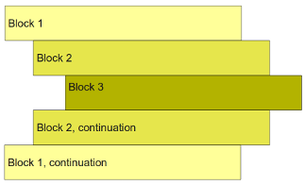
Indentation in python
A block is a group of statements in a program or script.
Python does not use braces({}) to indicate blocks of code for class and function definitions or flow control.
In python Blocks of code are denoted by line indentation.
Python programs get structured through indentation, i.e. code blocks are defined by their indentation.
T Seshu Chakravarthy Department Of Computer Science and Engineering

Slide 22
Cont …
All statements with the same distance to the right belong to the same block of code.
If a block has to be more deeply nested, it is simply indented further to the right.
Leading whitespace (spaces and tabs) at the beginning of a logical line is used to compute the indentation level of the line, which in turn is used to determine the grouping of statements.
T Seshu Chakravarthy Department Of Computer Science and Engineering

Slide 23
Cont …
Ex:
a=input("enter a")
b=input("enter b")
if a>b:
print('a is big')
print("hi")
else:
print("b is big")
T Seshu Chakravarthy Department Of Computer Science and Engineering

Slide 24
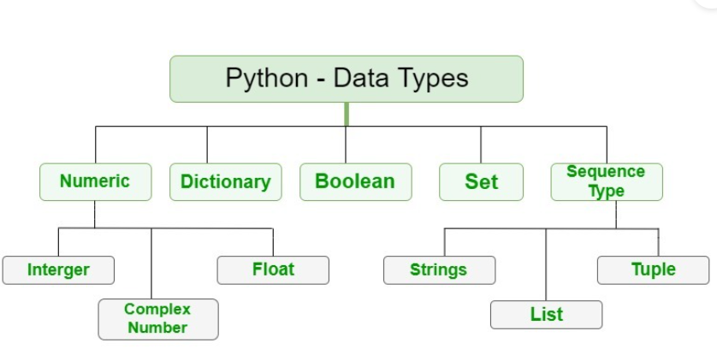
Basic Data types in Python
Every value in Python has a data type.
T Seshu Chakravarthy Department Of Computer Science and Engineering

Slide 25
Basic Data types in Python
Integers (int): Whole numbers, such as -5, 0, 42.
Floating-Point Numbers (float): Numbers with a decimal point, such as -3.14, 2.718.
Strings (str): Sequences of characters, enclosed in single (' ') or double (" ") quotes. For example, "Hello, World!".
Booleans (bool): Represents either True or False, often used for logical operations.
Lists (list): Ordered collections of items that can be of different data types. Lists are mutable (can be changed after creation). Example: [1, 2, 3, "apple"].
Tuples (tuple): Similar to lists, but immutable (cannot be changed after creation). Example: (1, 2, 3, "apple").
Dictionaries (dict): Key-value pairs, where each key maps to a value.
Example: {"name": "John", "age": 30}.
Sets (set): Unordered collections of unique elements. Example: {1, 2, 3}.
Complex Numbers (complex): Numbers with a real and an imaginary part. Example: 1 + 2j.
T Seshu Chakravarthy Department Of Computer Science and Engineering

Slide 26
Data types
We can use the type() function to know type a variable.
Ex:
a= 5
b = 2.0
c = 1+2j
d = "Hi"
e=[1,2,"bye"]
f=(5,6,1.2)
g={8,9,20}
h={"name":"Ram","id":70459}
print(a, "is of type:", type(a))
print(b, "is of type:", type(b))
print(c, "is of type :", type(c))
print(d, "is of type:", type(d))
print(e, "is of type:", type(e))
print(f, "is of type :", type(f))
print(g, "is of type :", type(g))
print(h, "is of type :", type(h))
Output:
5 is of type: <class 'int'>
2.0 is of type: <class 'float'>
(1+2j) is of type : <class 'complex'>
Hi is of type: <class 'str'>
[1, 2, 'bye'] is of type: <class 'list'>
(5, 6, 1.2) is of type : <class 'tuple'>
{8, 9, 20} is of type : <class 'set'>
{'name': 'Ram', 'id': 70459} is of type : <class 'dict'>
T Seshu Chakravarthy Department Of Computer Science and Engineering

Slide 27
Python Operators
Operators are used to perform operations on variables(operands).
Python provides the following operators:
Arithmetic operators
Assignment operators
Comparison operators
Logical operators
Identity operators
Membership operators
Bitwise operators
T Seshu Chakravarthy Department Of Computer Science and Engineering

Slide 28
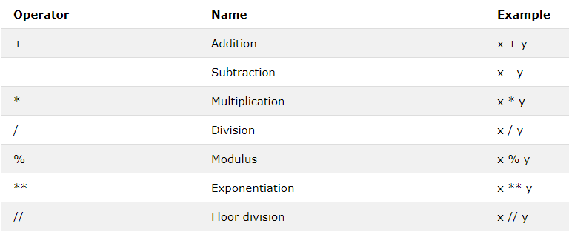
Arithmetic Operators
Arithmetic operators are used with numeric values to perform common mathematical operations
T Seshu Chakravarthy Department Of Computer Science and Engineering

Slide 29
Arithmetic Operators
x = 5
y = 2
print('Addition=',x+y)
print('subtraction =',x-y)
print('multiplication =',x*y)
print('division =',x/y)
print('Floor dvision =',x//y)
print('Remainder =',x%y)
print('Exponentiation =',x**y)
Output:
Addition= 7
subtraction = 3
multiplication = 10
division = 2.5
Floor dvision = 2
Remainder = 1
Exponentiation = 25
T Seshu Chakravarthy Department Of Computer Science and Engineering

Slide 30
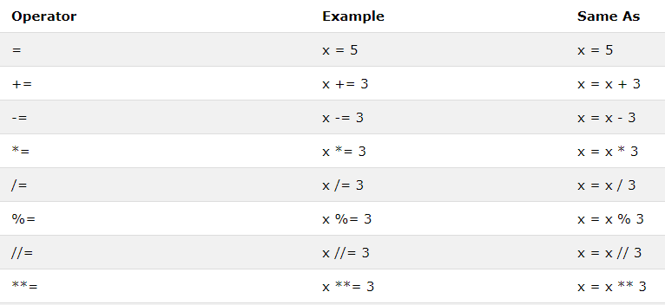
Assignment Operators
Assignment operators are used to assign values to variables:
T Seshu Chakravarthy Department Of Computer Science and Engineering

Slide 31
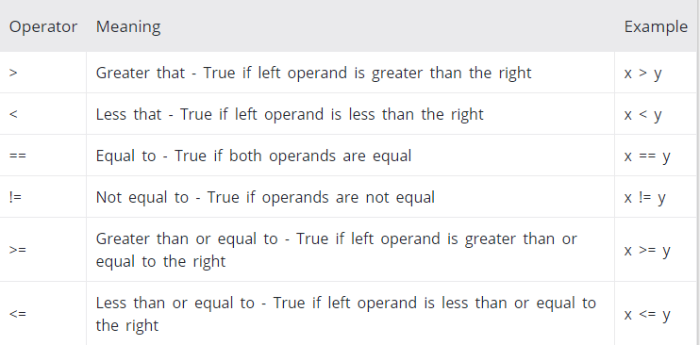
Comparison/Relational Operators
Comparison operators are used to compare two values:
It either returns True or False according to the condition.
T Seshu Chakravarthy Department Of Computer Science and Engineering

Slide 32
Comparison Operators
x = 10
y = 12
print('x > y is',x>y)
print('x < y is',x<y)
print('x == y is',x==y)
print('x != y is',x!=y)
print('x >= y is',x>=y)
print('x <= y is',x<=y)
T Seshu Chakravarthy Department Of Computer Science and Engineering

Slide 33
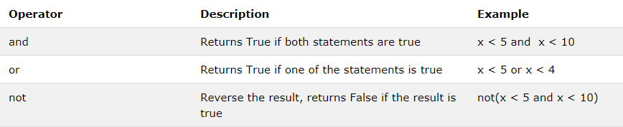
Logical Operators
Logical operators are used to combine conditional statements
Ex:
x = 5
print(x > 3 and x < 4)
print(x > 3 or x < 4)
print(not(x==5))
Output:
False
True
False
T Seshu Chakravarthy Department Of Computer Science and Engineering

Slide 34
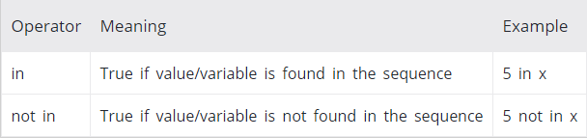
Membership operators
They are used to test whether a value or variable is found in a sequence (string, list, tuple, set and dictionary).
In a dictionary we can only test for presence of key, not the value.
T Seshu Chakravarthy Department Of Computer Science and Engineering

Slide 35
Membership operators
x = 'Hello world'
print('H' in x)
print('S' in x)
print('Hello' not in x)
Output:
True
False
False
T Seshu Chakravarthy Department Of Computer Science and Engineering

Slide 36
Bitwise operators
These operators act upon the individual bits (0 & 1) of their operands.
It operates bit by bit, hence the name.
For example, 2 is 10 in binary and 7 is 111.
Bitwise AND (&)
Bitwise OR (|)
Bitwise XOR (^)
Bitwise Complements (~)
Bitwise Left shift (<<)
Bitwise Right shift (>>)
T Seshu Chakravarthy Department Of Computer Science and Engineering

Slide 37
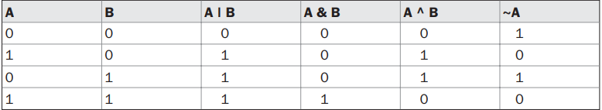
Bitwise operators
int x=10; int y=11;
X: 0000 1010
Y: 0000 1011
X&Y : 0000 1010
result is 10
X: 0000 1010
Y: 0000 1011
X|Y : 0000 1011
result is 11
X: 0000 1010
Y: 0000 1011
X^Y : 0000 0001
result is 1
a = 0011
~a = 1100
T Seshu Chakravarthy Department Of Computer Science and Engineering

Slide 38
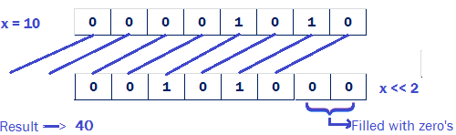
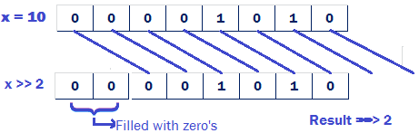
Bitwise operators
Bitwise Left Shift Operator «
This operator shifts the bits of the number towards left a specified number of positions.
X<<n=x*2^{n}
X=10;
X<<2=10x2²
=10x4= 40
Bitwise Right Shift Operator (»)
This operator shifts the bits of the number towards right a specified number of positions.
X=10;
X>>n=x/ 2^{n}
X>>2=10/2²
=10/4=2
T Seshu Chakravarthy Department Of Computer Science and Engineering

Slide 39
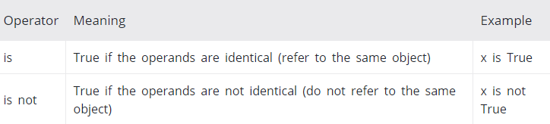
Identity operators
is and is not are the identity operators in Python.
Ex:
a1 = 3
b1 = 3
print(a1 is b1)
print(a1 is not b1)
T Seshu Chakravarthy Department Of Computer Science and Engineering

Slide 40
Precedence and Associativity of Operators in Python
Operators have different levels of precedence, which determine the order in which they are evaluated.
When multiple operators are present in an expression, the ones with higher precedence are evaluated first.
In the case of operators with the same precedence, their associativity comes into play, determining the order of evaluation.
What is the value of below expression?
10 + 20 * 30
T Seshu Chakravarthy Department Of Computer Science and Engineering

Slide 41
Precedence and Associativity of Operators in Python
Precedence | Operators | Description | Associativity
1 | () | Parentheses | Left to right
2 | ** | Exponentiation | Right to left
3 | ~x | bitwise NOT | Right to left
4 | *, @, /, //, % | Multiplication, matrix, division, floor division, remainder | Left to right
5 | +, – | Addition and subtraction | Left to right
6 | <<, >> | Shifts | Left to right
7 | & | Bitwise AND | Left to right
8 | ^ | Bitwise XOR | Left to right
9 | | | Bitwise OR | Left to right
10 | in, not in, is, is not, <, <=, >, >=, !=, == | Comparisons, membership tests, identity tests | Left to Right
11 | and | logical AND | Left to right
12 | or | Logical OR | Left to right
18 | := | Assignment expression (walrus operator) | Right to left
T Seshu Chakravarthy Department Of Computer Science and Engineering

Slide 42
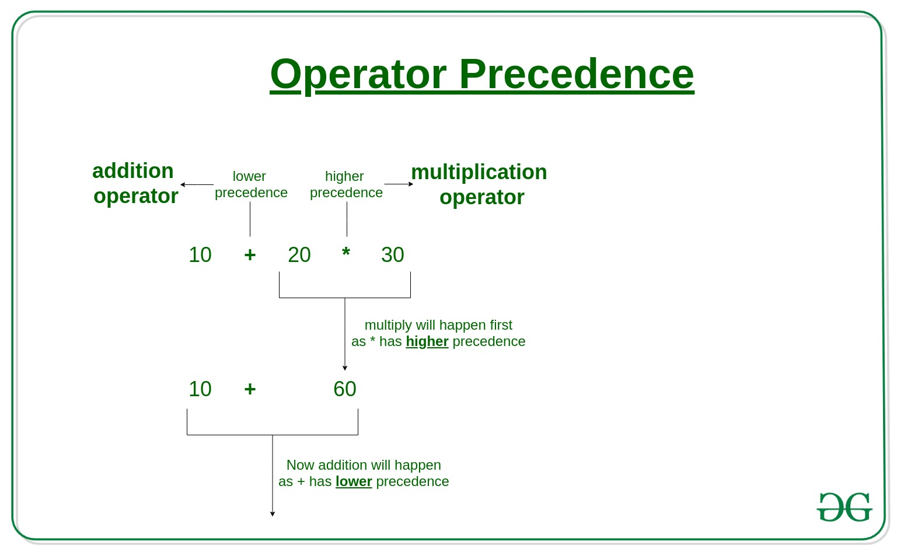
Precedence and Associativity of Operators in Python
100 / 10 * 10
In this expression ‘*’ and ‘/’ have the same precedence and their associativity is Left to Right,
so the expression “100 / 10 * 10” is evaluated as
=(100 / 10) * 10
=10*10
value=100
3. What is the value of 100 + 200 / 10 - 3 * 10
4. What is the value of 4+3*2&4|6
T Seshu Chakravarthy Department Of Computer Science and Engineering

Slide 43
What is the value of 100 + 200 / 10 - 3 * 10
First, perform the multiplication and division:
200 / 10 = 20
3 * 10 = 30
Then, perform the addition and subtraction from left to right:
100 + 20 = 120
120 - 30 = 90
So, the value of the expression "100 + 200 / 10 - 3 * 10" is 90.
What is the value of 4+3*2&4|6
Multiplication: 3 * 2 = 6
Addition: 4 + 6 = 10
Bitwise AND: 10 & 4 = 0 (In binary, 10 is 1010 and 4 is 0100. The result of a bitwise AND is 0 where there are differing bits.)
Bitwise OR: 0 | 6 = 6 (In binary, 0 is 0000 and 6 is 0110. The result of a bitwise OR is 1 where there is at least one 1.)
So, the final result of the expression is 6.
T Seshu Chakravarthy Department Of Computer Science and Engineering

Slide 44
Evaluate the expression step by step according to operator precedence and associativity and print the final output for x = 10 and y = 50 x ** 2 > 100 and y < 100
Let's evaluate it step by step:
Evaluate x ** 2:
x = 10
x ** 2 = 10 ** 2 = 100
Evaluate y < 100:
y = 50
y < 100 is true because 50 is indeed less than 100.
Now, we have 100 > 100 and True. To evaluate the and operator, we need both sides to be True for the whole expression to be True. Since the first part, 100 > 100, is False (because 100 is not greater than 100), the whole expression is False.
So, the final output for x = 10 and y = 50 is False.
T Seshu Chakravarthy Department Of Computer Science and Engineering

Slide 45
Write a python program which prompts a user to enter the Basic salary to calculate the Total salary of an Employee considering the bonus and conveyance offered to him. Display the Total salary with two digits after the decimal point.
HRA = 20% of Basic
DA = 105 % of Basic
Conveyance = Rs1300
Bonus = Rs1000
Code:
# Get the basic salary from the user
basic_salary = float(input("Enter the Basic salary: "))
hra = 0.20 * basic_salary
da = 1.05 * basic_salary
conveyance = 1300
bonus = 1000
total_salary = basic_salary + hra + da + conveyance + bonus
print(f"Total Salary: {total_salary:.2f}")
T Seshu Chakravarthy Department Of Computer Science and Engineering

Slide 46
Decision making (or) conditional Statements
Decision making is required when we want to execute a code only if a certain condition is satisfied.
The if statement
The if else statement
if...elif...else Statement
Nested if statements
T Seshu Chakravarthy Department Of Computer Science and Engineering

Slide 47
if statement
Syntax:
if test expression:
statement(s)
Here, the program evaluates the test expression and will execute statement(s) only if the text expression is True.
If the text expression is False, the statement(s) is not executed.
In Python, the body of the if statement is indicated by the indentation.
Body starts with an indentation and the first unindented line marks the end.
T Seshu Chakravarthy Department Of Computer Science and Engineering

Slide 48
if statement
num = 3
if num>0:
print(num, "is a positive number.")
print("This is always printed.")
T Seshu Chakravarthy Department Of Computer Science and Engineering

Slide 49
if...else Statement
Syntax:
if test expression:
Body of if
else:
Body of else
The if..else statement evaluates test expression and will execute body of if only when test condition is True.
If the condition is False, body of else is executed.
Indentation is used to separate the blocks.
T Seshu Chakravarthy Department Of Computer Science and Engineering

Slide 50
if...else Statement
no=input("enter number")
no=int(no)
if(no%5==0 and no%11==0):
print("number is divisible by 5 and 11")
else:
print("number is not divisible by 5 and 11")
T Seshu Chakravarthy Department Of Computer Science and Engineering

Slide 51
if...elif...else Statement
if condition1:
# Code to be executed if condition1 is True
elif condition2:
# Code to be executed if condition2 is True
else:
# Code to be executed if none of the conditions are True
if...elif...else Statement allows you to execute different blocks of code based on specified conditions.
T Seshu Chakravarthy Department Of Computer Science and Engineering

Slide 52
if...elif...else Statement
If the condition for if is False, it checks the condition of the next elif block and so on.
If all the conditions are False, body of else is executed.
Only one block among the several if...elif...else blocks is executed according to the condition.
The if block can have only one else block. But it can have multiple elif blocks.
T Seshu Chakravarthy Department Of Computer Science and Engineering

Slide 53
if...elif...else Statement
a=int(input("enter numbers"))
b=int(input("enter numbers"))
c=int(input("enter numbers"))
if(a>b and a>c):
print(a,"is big")
elif b>c:
print(b,"is big")
else:
print(c,"is big")
T Seshu Chakravarthy Department Of Computer Science and Engineering

Slide 54
Nested if statement
We can have a if...elif...else statement inside another
if...elif...else statement. This is called nesting in computer programming.
Example:
num = int(input("Enter a number: "))
if num >= 0:
if num == 0:
print("Zero")
else:
print("Positive number")
else:
print("Negative number")
T Seshu Chakravarthy Department Of Computer Science and Engineering

Slide 55
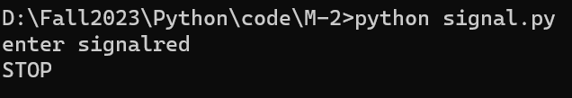
Program:
signal=input ("enter signal")
if(signal=="red"):
print("STOP")
elif(signal=="orange"):
print ("Be slow")
elif(signal=="green"):
print ("to go")
else:
print("error")
T Seshu Chakravarthy Department Of Computer Science and Engineering

Slide 56
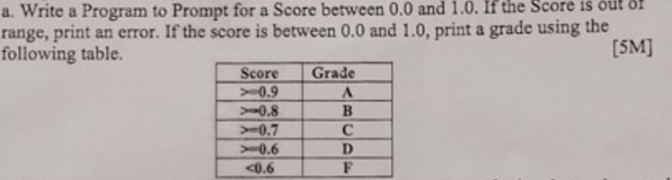
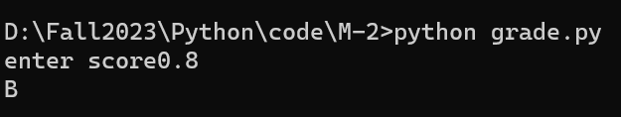
score=float(input("enter score"))
if(score>=0.9 and score<=1.0):
print("A")
elif(score>=0.8 and score<0.9):
print("B")
elif(score>=0.7 and score<0.8):
print("C")
elif(score>=0.6 and score<0.7):
print("D")
elif(score<0.6):
print("F")
else:
print("error")
T Seshu Chakravarthy Department Of Computer Science and Engineering

Slide 57
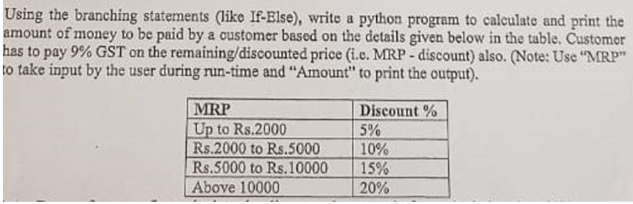
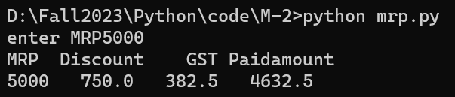
MRP=int(input("enter MRP"))
if(MRP>=1 and MRP<2000):
discount=0.05*MRP
elif(MRP>=2000 and MRP<5000):
discount=0.1*MRP
elif(MRP>=5000 and MRP<10000):
discount=0.15*MRP
elif(MRP>10000):
discount=0.2*MRP
else:
print("error")
amount=MRP-discount
GST=0.09*amount
paidamount=amount+GST
print("MRP Discount GST Paidamount")
print(MRP," ",discount," ",GST," ",paidamount)
T Seshu Chakravarthy Department Of Computer Science and Engineering

Slide 58
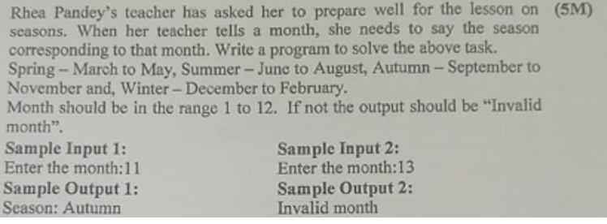

# Get the month from the user
month = int(input("Enter a month (1-12): "))
# Check the month and determine the season
if month in [12, 1, 2]:
season = "Winter"
elif month in [3, 4, 5]:
season = "Spring"
elif month in [6, 7, 8]:
season = "Summer"
elif month in [9, 10, 11]:
season = "Autumn"
else:
season = "Invalid month"
print(season)
T Seshu Chakravarthy Department Of Computer Science and Engineering

Slide 59

T Seshu Chakravarthy Department Of Computer Science and Engineering

Slide 60
End
T Seshu Chakravarthy Department Of Computer Science and Engineering

